Slide 1
Lecture 6: Overfitting, model selection and regularization

Slide 2
What’s Next
Overfitting
Applications of Model Selection
Behind Ordinary Lease Squares, AIC, BIC
Bias vs Variance
Regularization: LASSO and Ridge
Regularization Methods: A Comparison

Slide 3
Overfitting
Finding subsets of significant predictors is an important for model interpretation. But there is another strong reason to model using the smaller set of significant predictors: to avoid overfitting.
Question: What is overfitting?

Slide 4
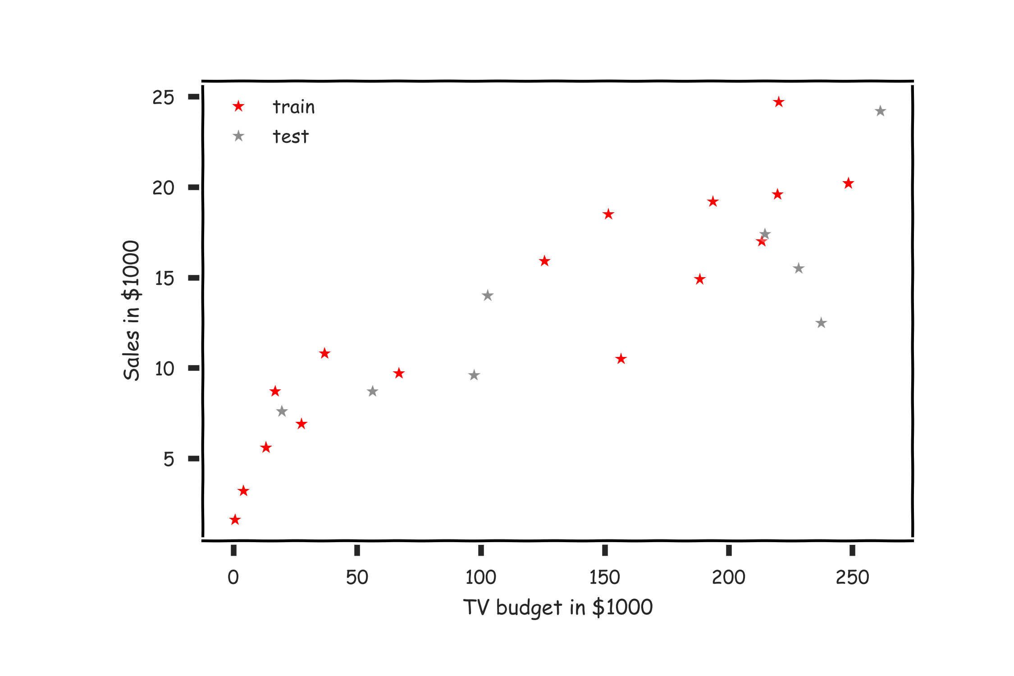
Overfitting

Slide 5
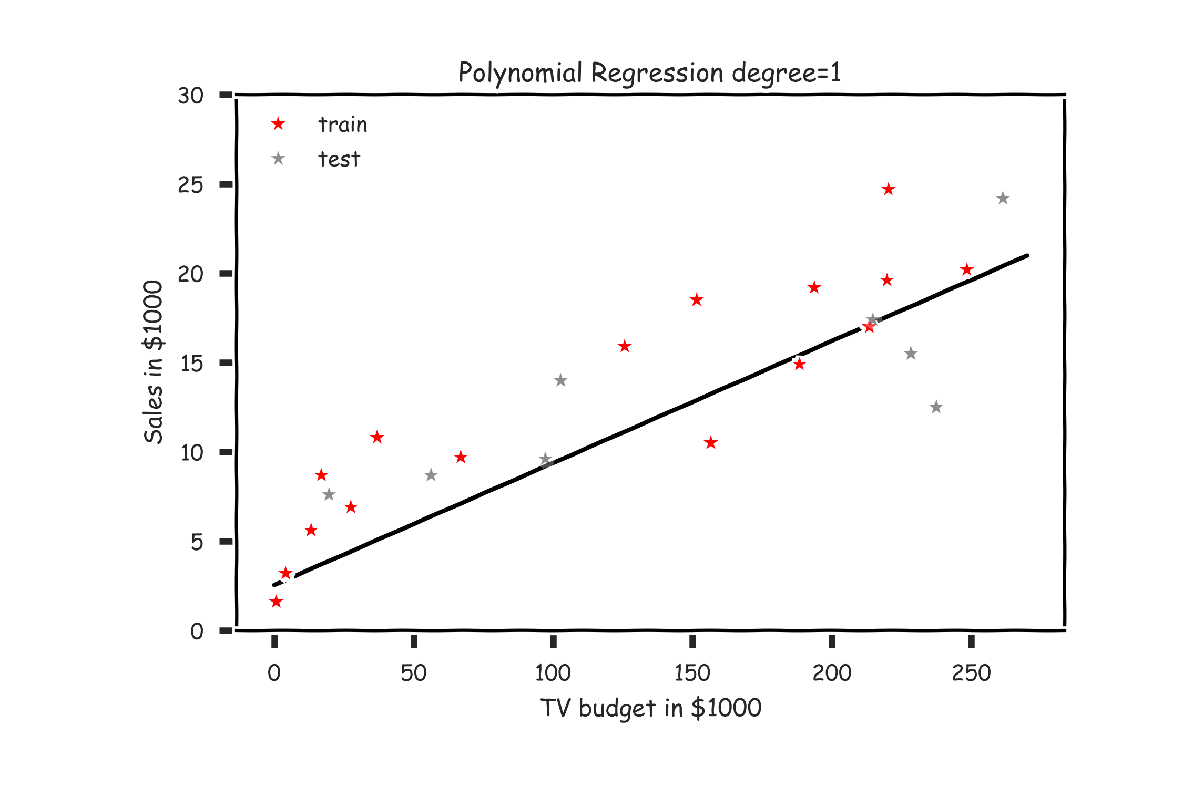
Overfitting

Slide 6
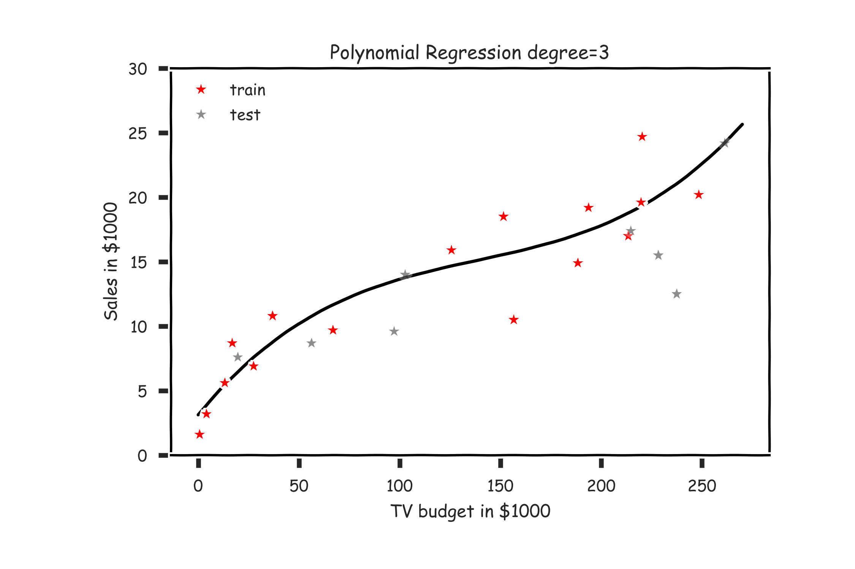
Overfitting

Slide 7
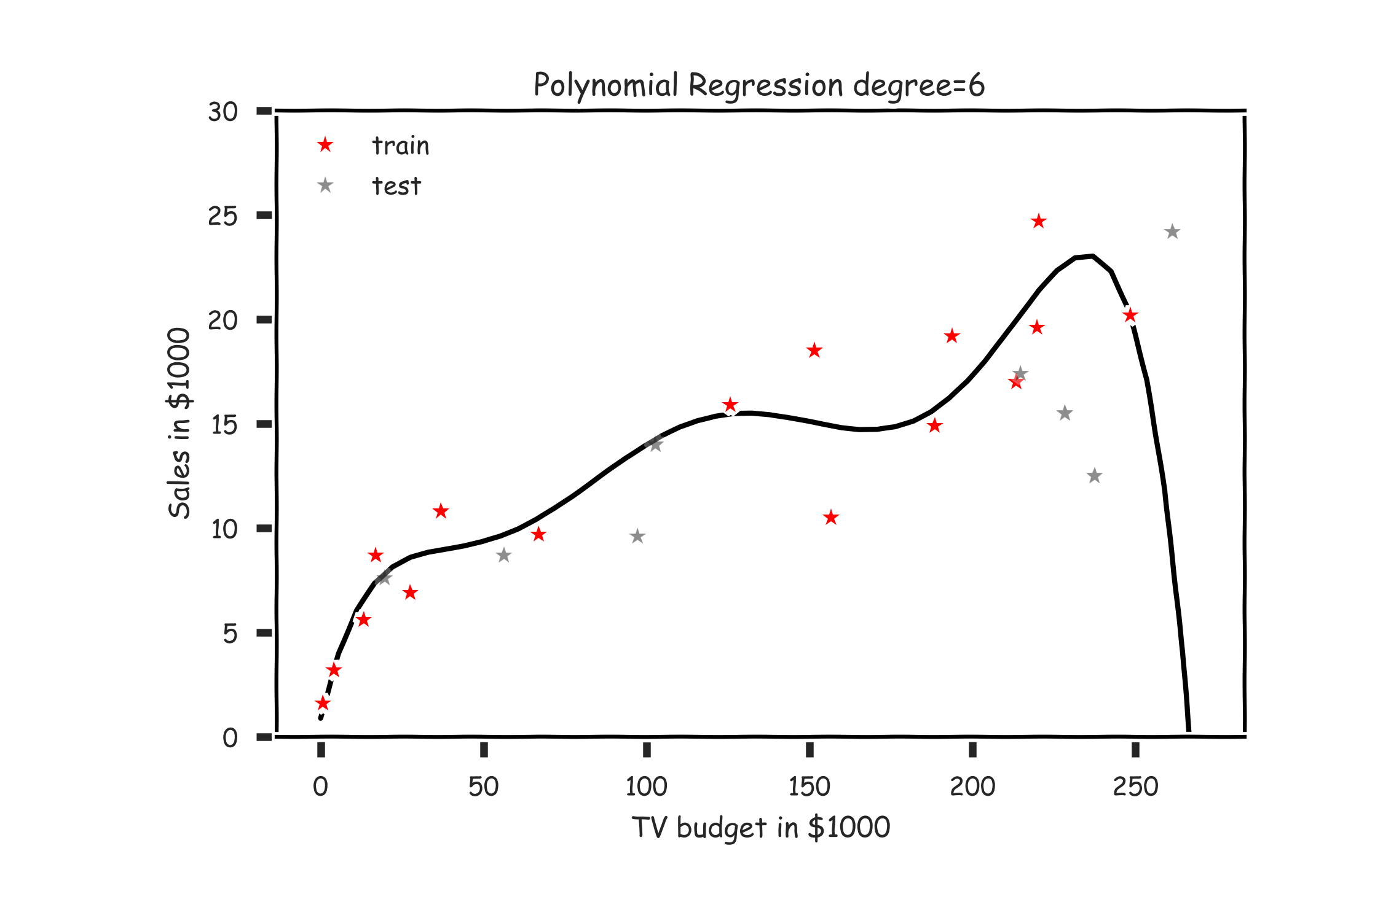
Overfitting

Slide 8
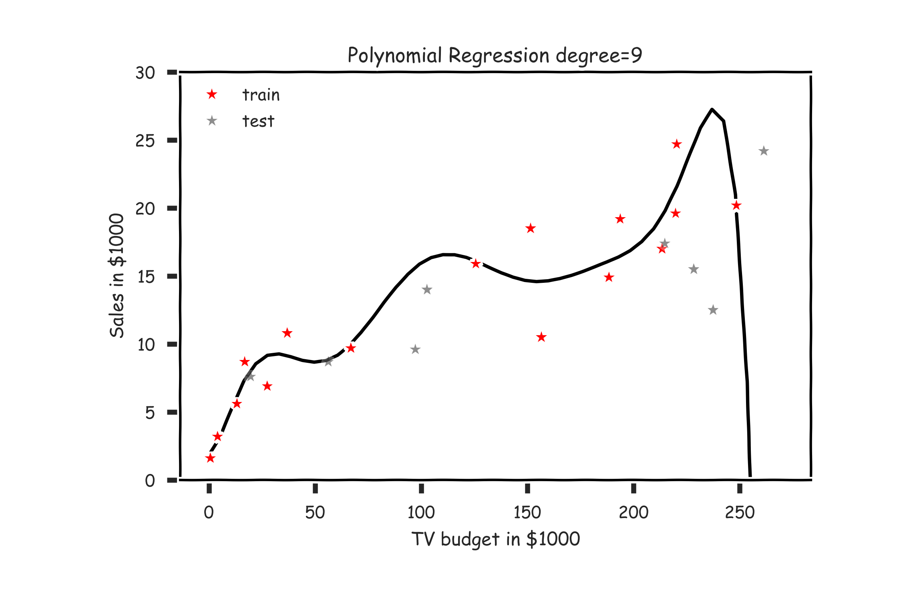
Overfitting

Slide 9
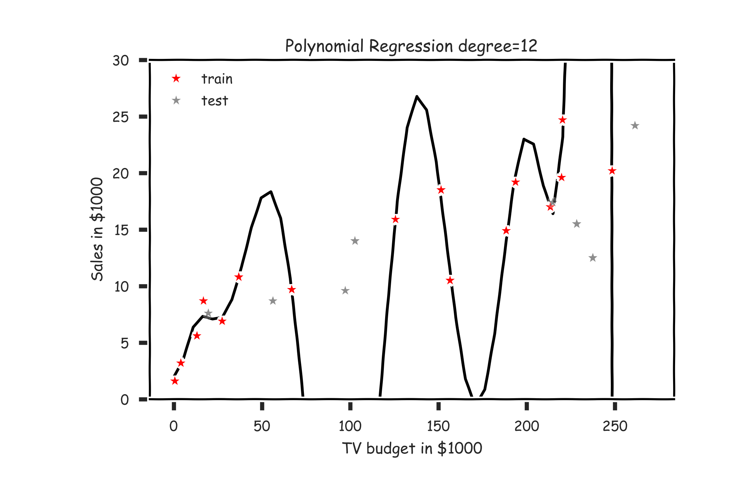
Overfitting

Slide 10
Overfitting
Definition
Overfitting is the phenomenon where the model is unnecessarily complex, in the sense that portions of the model captures the random noise in the observation, rather than the relationship between predictor(s) and
response. Overfitting causes the model to lose predictive power on
new data.
Overfitting causes the model to lose predictive power on new data.

Slide 11
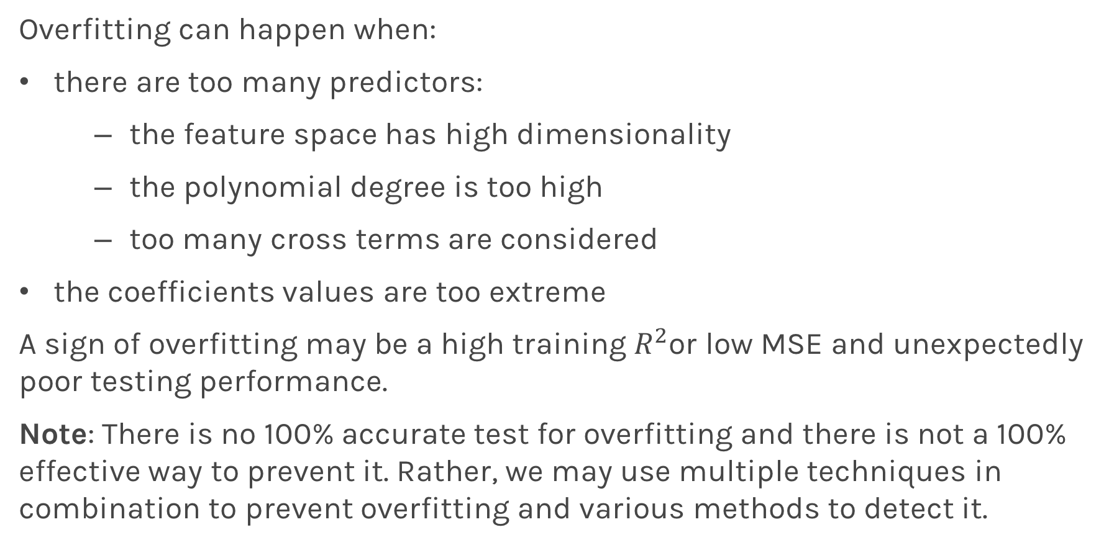
Causes of Overfitting
Overfitting can happen when:
there are too many predictors:
the feature space has high dimensionality
the polynomial degree is too high
too many cross terms are considered
the coefficients values are too extreme
A sign of overfitting may be a high training $R^{2}$or low MSE and unexpectedly poor testing performance.
Note: There is no 100% accurate test for overfitting and there is not a 100% effective way to prevent it. Rather, we may use multiple techniques in combination to prevent overfitting and various methods to detect it.

Slide 12
Model Selection
Model selection is the application of a principled method to determine the complexity of the model, e.g. choosing a subset of predictors, choosing the degree of the polynomial model etc.
Model selection typically consists of the following steps:
split the training set into two subsets: training and validation
multiple models (e.g. polynomial models with different degrees) are fitted on the training set; each model is evaluated on the validation set
the model with the best validation performance is selected
the selected model is evaluated one last time on the testing set

Slide 13
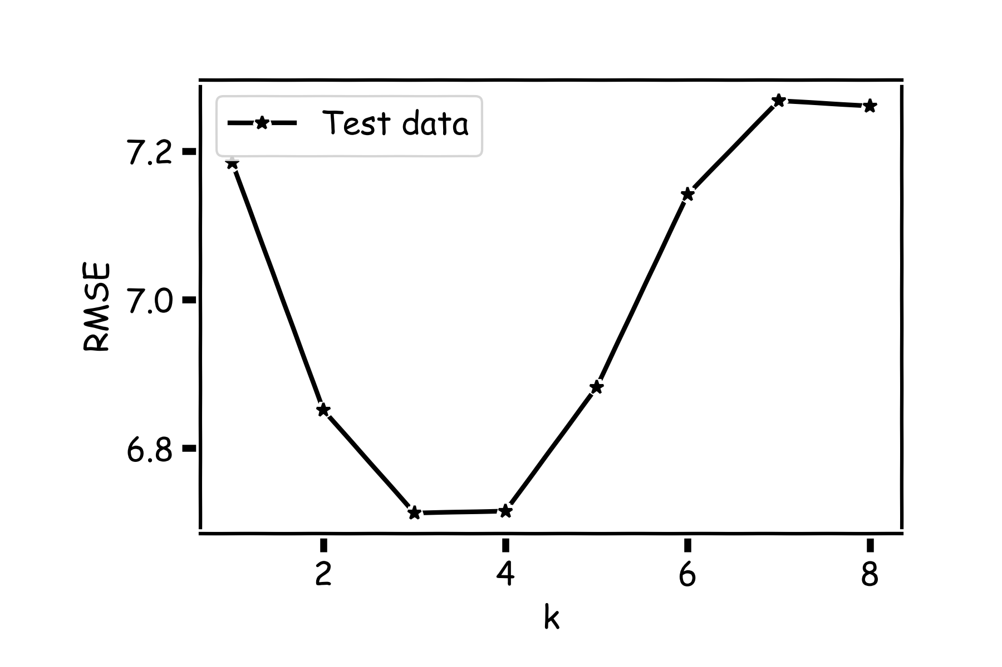
Model Comparison
Do the same for all k’s and compare the RMSEs. k=3 seems to be the best model.

Slide 14
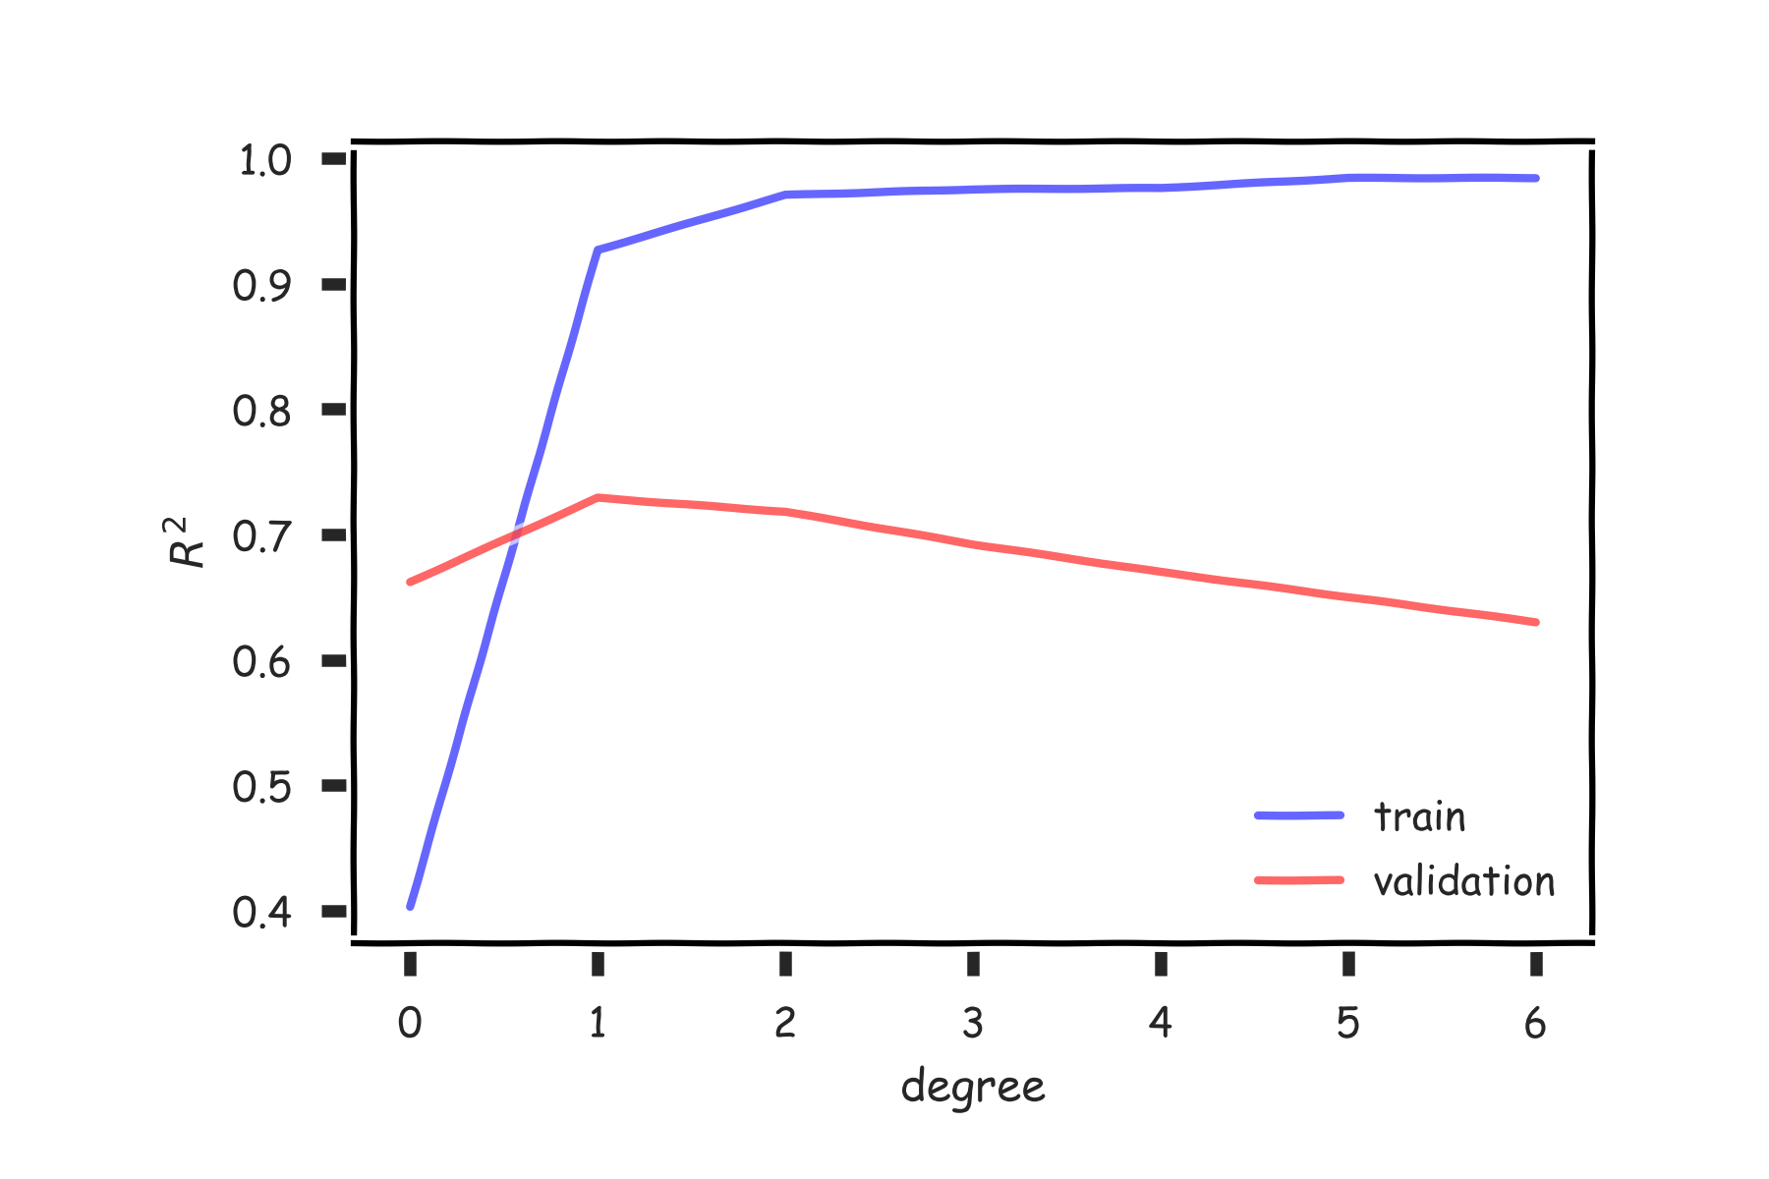
Cross Validation

Slide 15
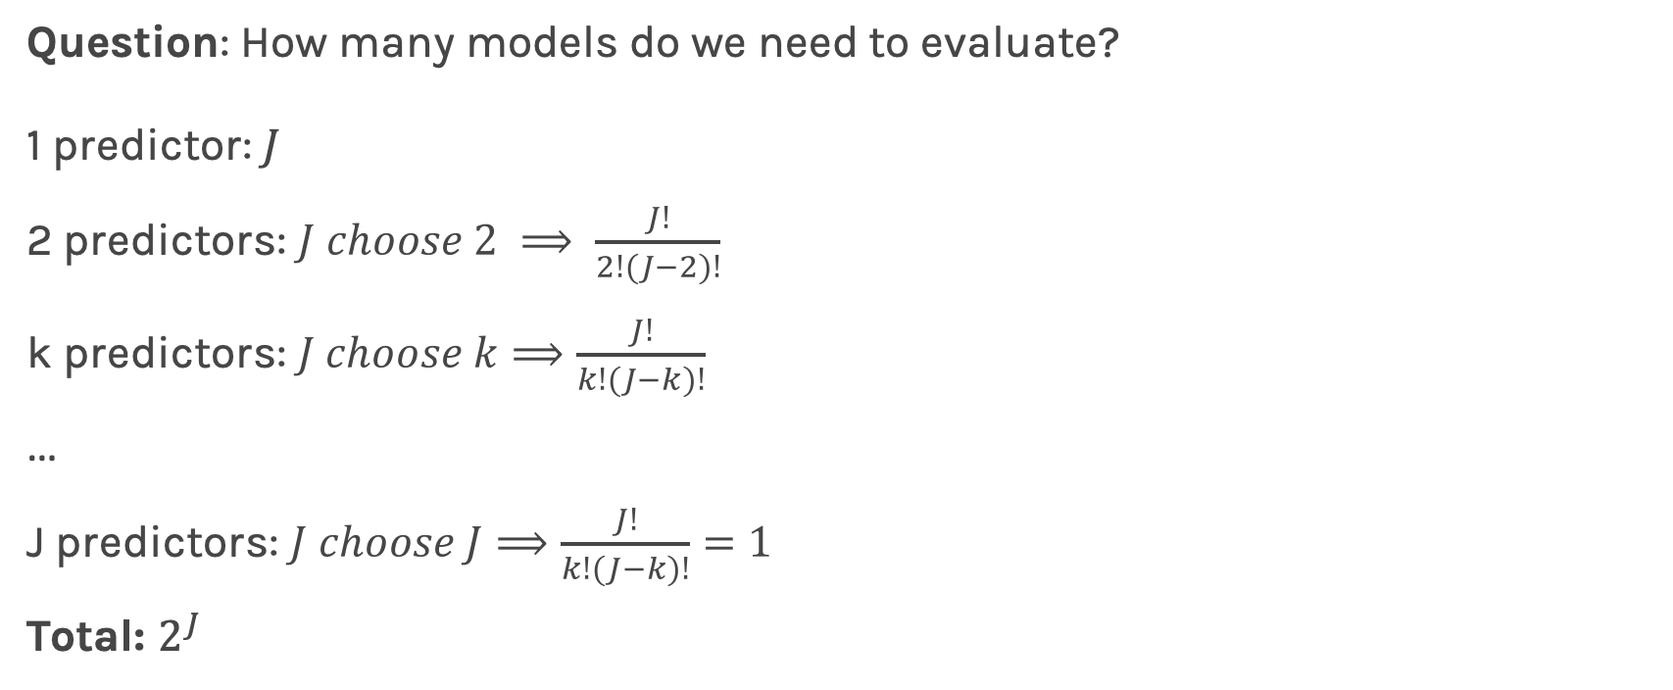
Variable Selection Computational Complexity
Question: How many models do we need to evaluate?
1 predictor: $J$
2 predictors: $J choose 2 ⟹ \frac{J!}{2!\left(J−2\right)!}$
k predictors: $J choose k⟹\frac{J!}{k!\left(J−k\right)!}$
…
J predictors: $J choose J⟹\frac{J!}{k!\left(J−k\right)!}=1$
Total: $2^{J}$

Slide 16
Stepwise Variable Selection and Cross Validation
Selecting optimal subsets of predictors (including choosing the degree of polynomial models) through:
stepwise variable selection - iteratively building an optimal subset of predictors by optimizing a fixed model evaluation metric each time,
validation - selecting an optimal model by evaluating each model on validation set.
We will also address the issue of discouraging extreme values in model parameters later.

Slide 17
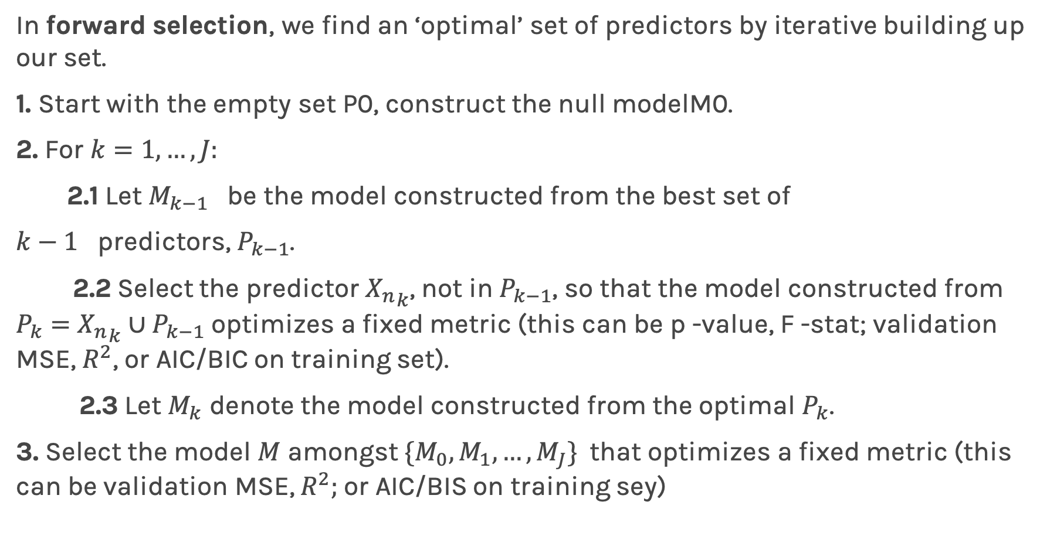
Stepwise Variable Selection: Forward method
In forward selection, we find an ‘optimal’ set of predictors by iterative building up our set.
1. Start with the empty set P0, construct the null modelM0.
2. For $k=1,…, J:$
2.1 Let $M_{k−1}$ be the model constructed from the best set of
$k−1$ predictors, $P_{k−1}$.
2.2 Select the predictor ${X_{n}}_{k}$, not in $P_{k−1}$, so that the model constructed from $P_{k}=$ ${X_{n}}_{k}∪P_{k−1}$ optimizes a fixed metric (this can be p -value, F -stat; validation MSE, $R^{2}$, or AIC/BIC on training set).
2.3 Let $M_{k}$ denote the model constructed from the optimal $P_{k}$.
3. Select the model $M$ amongst $\{M_{0}, M_{1},…, M_{J}\}$that optimizes a fixed metric (this can be validation MSE, $R^{2};$or AIC/BIS on training sey)

Slide 18
Stepwise Variable Selection Computational Complexity
How many models did we evaluate?
1st step, J Models
2nd step, J-1 Models (add 1 predictor out of J-1 possible)
3rd step, J-2 Models (add 1 predictor out of J-2 possible)
…

Slide 19
Cross Validation

Slide 20
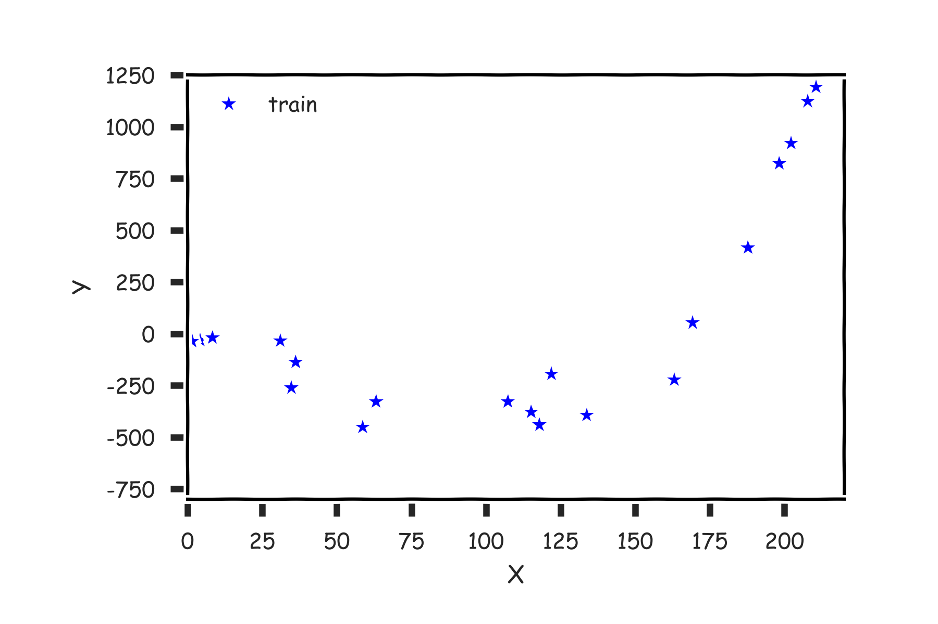
Cross Validation Motivation

Slide 21
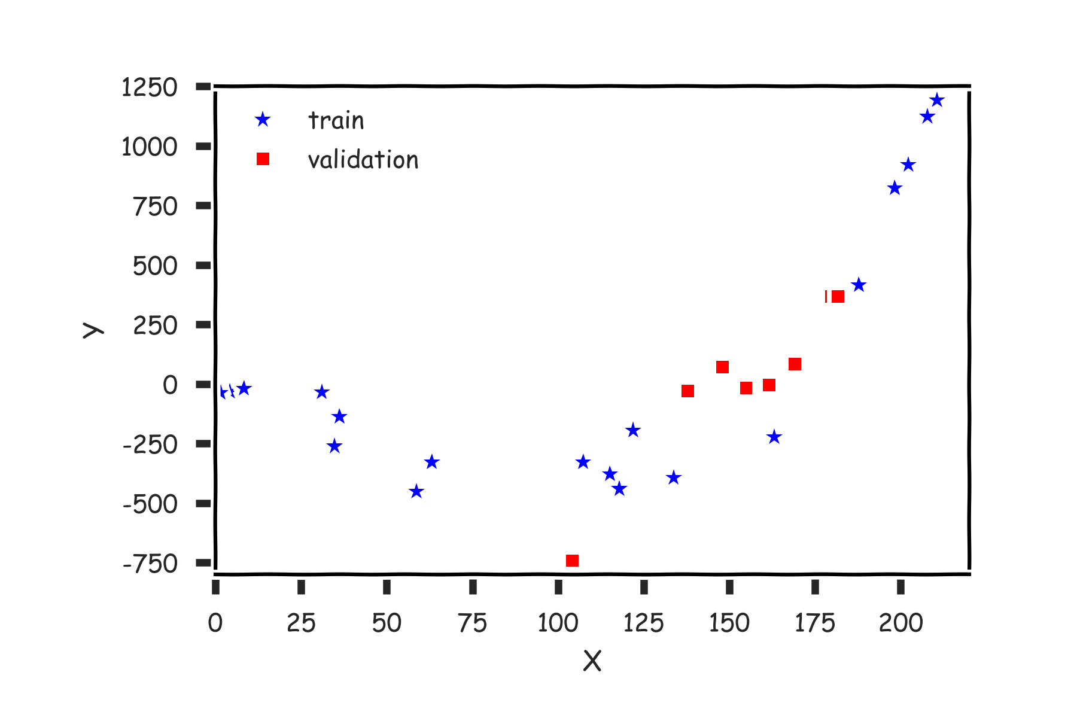
Cross Validation

Slide 22
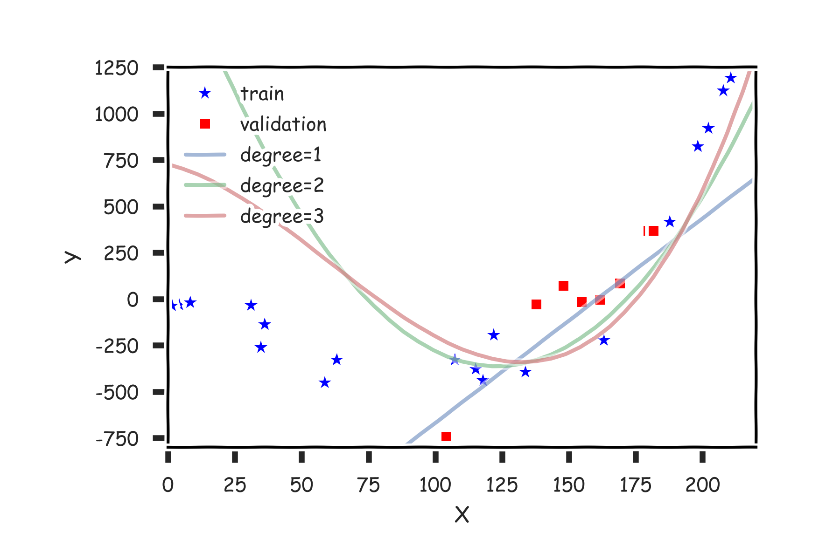
Cross Validation

Slide 23
Cross Validation

Slide 24
Cross Validation
Using a single validation set to select amongst multiple models can be problematic - there is the possibility of overfitting to the validation set.
One solution to the problems raised by using a single validation set is to evaluate each model multiple validation sets and average the validation performance.
One can randomly split the training set into training and validation multiple times, but randomly creating these sets can create the scenario where important features of the data never appear in our random draws.

Slide 25
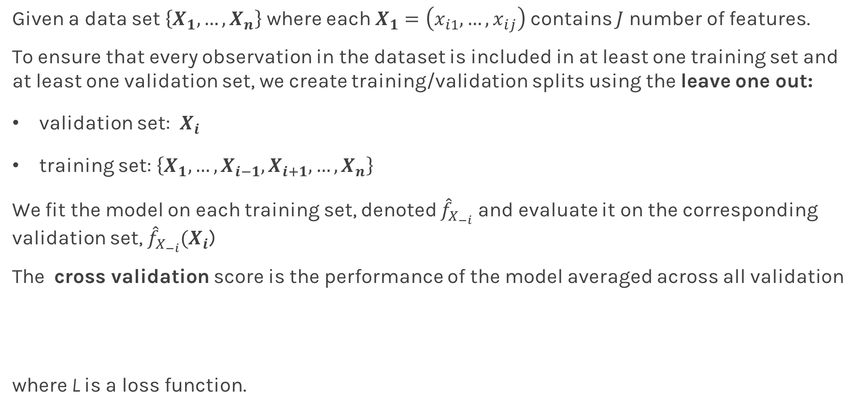
Leave-One-Out
Given a data set $\left\{X_{1},…,X_{n}\right\}$ where each $X_{1}=\left(x_{i1},…,x_{ij}\right)$ contains $J$ number of features.
To ensure that every observation in the dataset is included in at least one training set and at least one validation set, we create training/validation splits using the leave one out:
validation set: $X_{i}$
training set: $\left\{X_{1},…,X_{i−1},X_{i+1},…,X_{n}\right\}$
We fit the model on each training set, denoted ${\hat{f}}_{X_{−i}}$and evaluate it on the corresponding validation set, ${\hat{f}}_{X_{−i}}(X_{i}$)
The cross validation score is the performance of the model averaged across all validation
where L is a loss function.

Slide 26
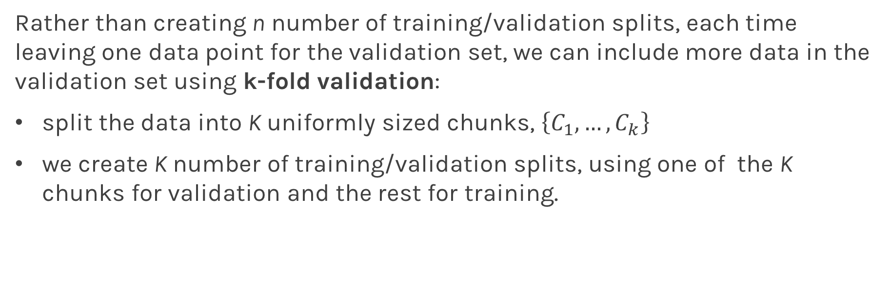
K-Fold Cross Validation
Rather than creating n number of training/validation splits, each time leaving one data point for the validation set, we can include more data in the validation set using k-fold validation:
split the data into K uniformly sized chunks, $\left\{C_{1},…, C_{k}\right\}$
we create K number of training/validation splits, using one of the K chunks for validation and the rest for training.

Slide 27
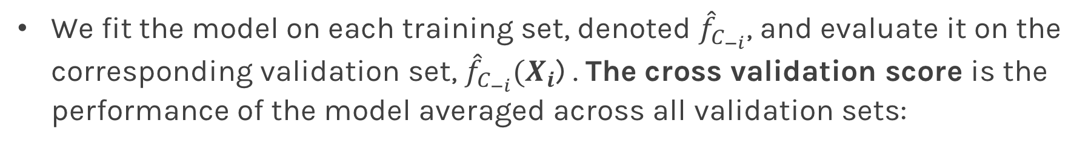
K-Fold Cross Validation
We fit the model on each training set, denoted ${\hat{f}}_{C_{−i}}$, and evaluate it on the corresponding validation set, ${\hat{f}}_{C_{−i}}(X_{i}$) . The cross validation score is the performance of the model averaged across all validation sets:

Slide 28
Predictor Selection: Cross Validation
Rather than choosing a subset of significant predictors using stepwise selection with train/validation method, we can use K-fold cross validation:
create a collection of different subsets of the predictors for each subset of predictors, compute the cross
validation score for the model created using only that subset
select the subset (and the corresponding model) with the best cross validation score
evaluate the model one last time on the test set
Question: What is the difference in multiple predictors and polynomial regression in model selection?

Slide 29
Predictor Selection: Cross Validation
We can frame the problem of degree selection for polynomial models as a predictor selection problem: which of the predictors
should we select for modeling?
We can apply stepwise selection to determine the optimal subset of predictors.

Slide 30
Degree Selection: Cross Validation
We can also select the degree of a polynomial model using K-fold cross validation sequentially.
consider a number of different degrees for each degree, compute the cross validation score for a polynomial model of that degree
select the degree, and the corresponding model with the best cross validation score
evaluate the model one last time on the test set.

Slide 31

kNN Revisited

Slide 32
kNN Revisited
Recall our first simple, intuitive, non-parametric model for regression - the kNN model. We saw that it is vitally important to select an appropriate k for the data.
If the k is too small then the model is very sensitive to noise (since a new prediction is based on very few observed neighbors), and if the k is too large, the model tends towards making constant predictions.
A principled way to choose k is through K-fold cross validation.

Slide 33
Without CV
In many scenarios, data are not abundant and therefor CV may not be feasible.
What if we do not have enough data to do CV?

Slide 34
Behind Ordinary Lease Squares, AIC, BIC

Slide 35
AIC and BIC
We’ve mentioned using AIC/BIC to evaluate the explanatory powers of models. The following formulae can be used to calculate these criteria:
where J is the number of predictors in model.
Intuitively, AIC/BIC is a loss function that depends both on the predictive error, RSS, and the complexity of the model. We see that we prefer a model with few parameters and low RSS.
But why do the formulae look this way - what is the justification?

Slide 36
Back to MSE

Slide 37
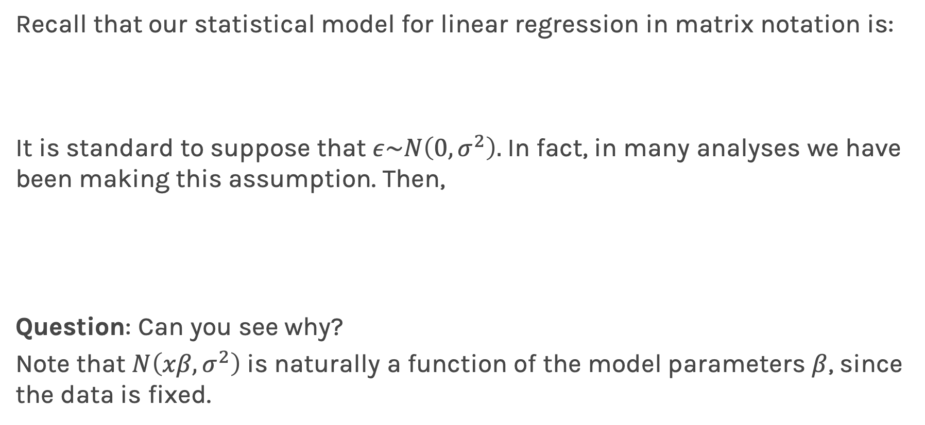
Likelihood Functions
Recall that our statistical model for linear regression in matrix notation is:
It is standard to suppose that $ε\sim N\left(0,σ^{2}\right).$In fact, in many analyses we have been making this assumption. Then,
Question: Can you see why?
Note that $N\left(xβ,σ^{2}\right)$ is naturally a function of the model parameters $β$, since the data is fixed.

Slide 38
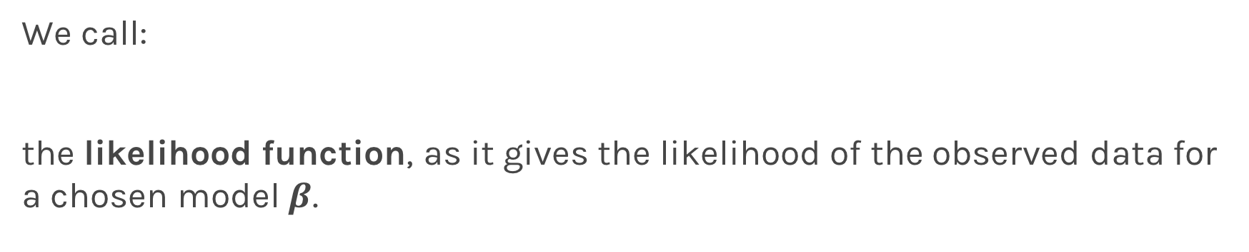
Likelihood Functions
We call:
the likelihood function, as it gives the likelihood of the observed data for a chosen model $β$.

Slide 39
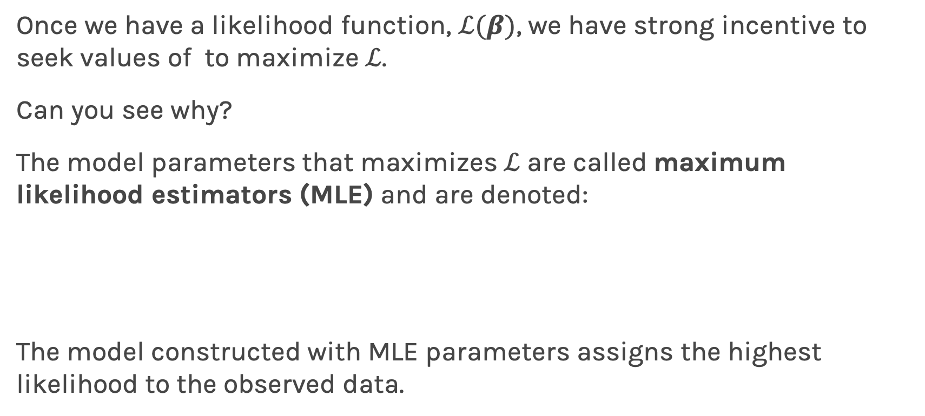
Maximum Likelihood Estimators
Once we have a likelihood function, $ℒ(β)$, we have strong incentive to seek values of to maximize $ℒ$.
Can you see why?
The model parameters that maximizes $ℒ$ are called maximum likelihood estimators (MLE) and are denoted:
The model constructed with MLE parameters assigns the highest likelihood to the observed data.

Slide 40
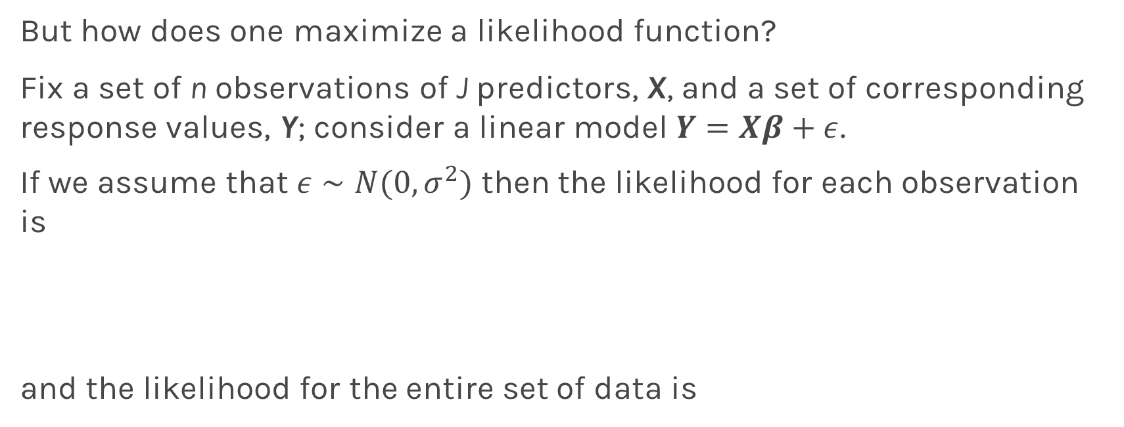
Maximum Likelihood Estimators
But how does one maximize a likelihood function?
Fix a set of n observations of J predictors, X, and a set of corresponding response values, Y; consider a linear model $Y=Xβ+ε$.
If we assume that $ε∼Ν(0,σ^{2})$ then the likelihood for each observation is
and the likelihood for the entire set of data is

Slide 41
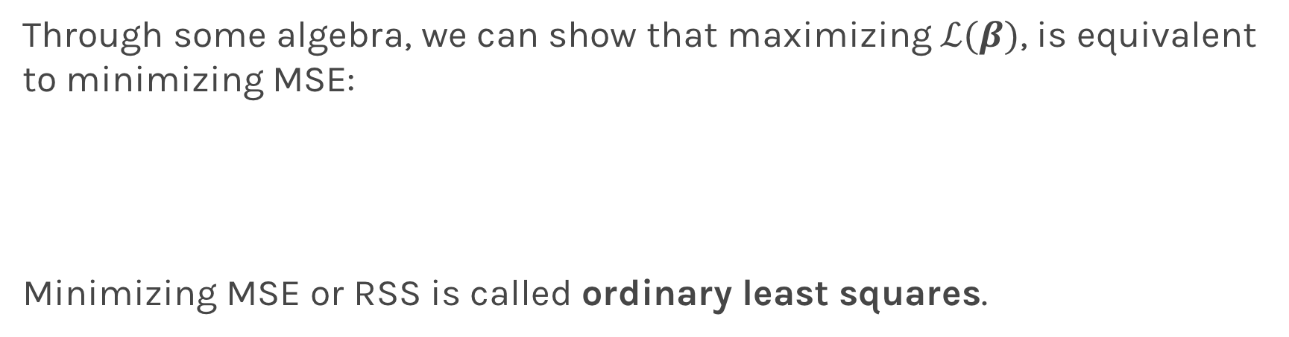
Maximum Likelihood Estimators
Through some algebra, we can show that maximizing $ℒ(β)$, is equivalent to minimizing MSE:
Minimizing MSE or RSS is called ordinary least squares.

Slide 42
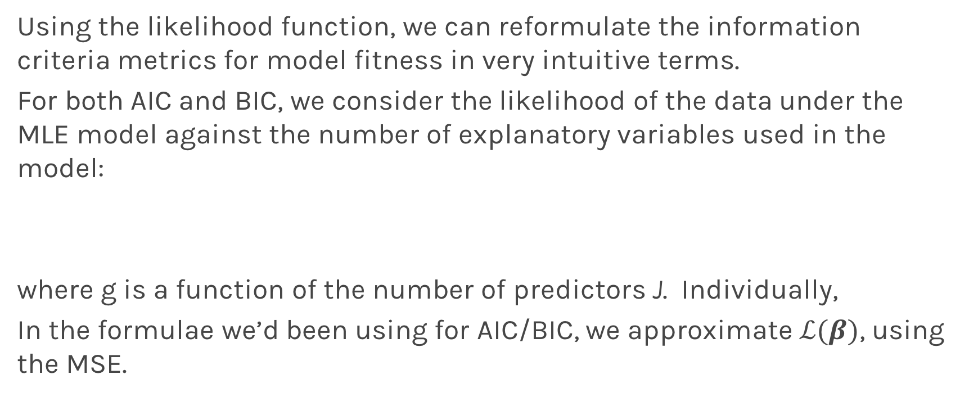
Information Criteria Revisited
Using the likelihood function, we can reformulate the information criteria metrics for model fitness in very intuitive terms.
For both AIC and BIC, we consider the likelihood of the data under the MLE model against the number of explanatory variables used in the model:
where g is a function of the number of predictors J. Individually,
In the formulae we’d been using for AIC/BIC, we approximate $ℒ(β)$, using the MSE.

Slide 43
Bias vs Variance

Slide 46
Bias vs Variance
Left: 200 best fit straight lines, each a fit on a different 30 point training sets from a 200 point population.
Right: Best-fit models using degree 20 polynomial

Slide 47
Bias vs Variance
Left: Linear regression coefficients
Right: Poly regression of order 20 coefficients

Slide 48
Variance

Slide 49
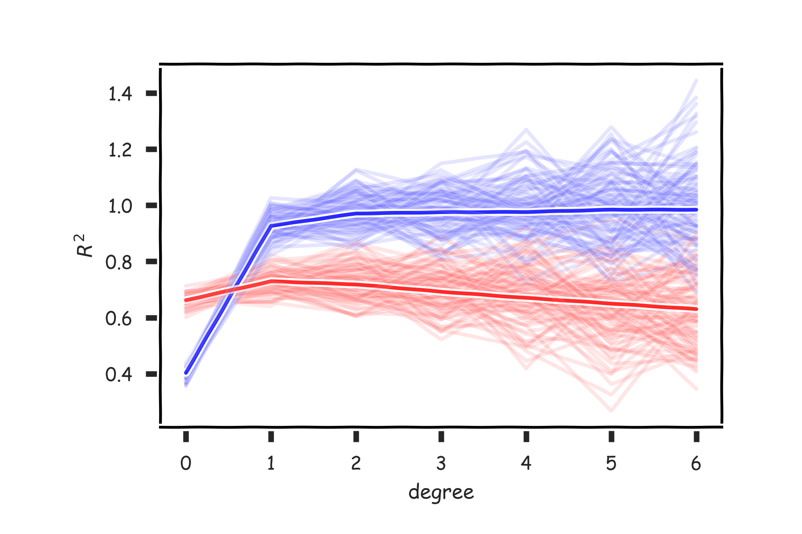
Variance

Slide 50
Regularization: LASSO and Ridge

Slide 51
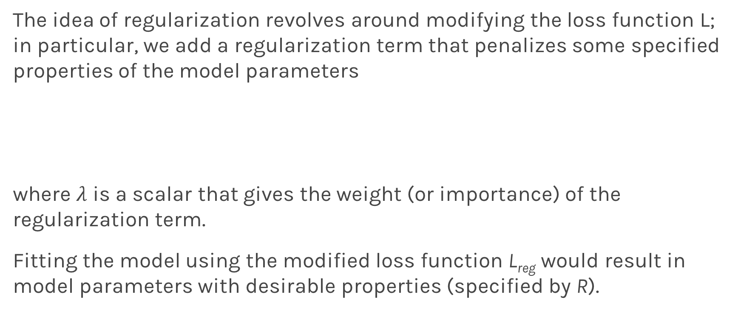
Regularization: An Overview
The idea of regularization revolves around modifying the loss function L; in particular, we add a regularization term that penalizes some specified properties of the model parameters
where $λ$ is a scalar that gives the weight (or importance) of the regularization term.
Fitting the model using the modified loss function L_{reg} would result in model parameters with desirable properties (specified by R).

Slide 52
LASSO Regression
Since we wish to discourage extreme values in model parameter, we need to choose a regularization term that penalizes parameter magnitudes. For our loss function, we will again use MSE.
Together our regularized loss function is:
Note that is the l₁ norm of the vector β

Slide 53
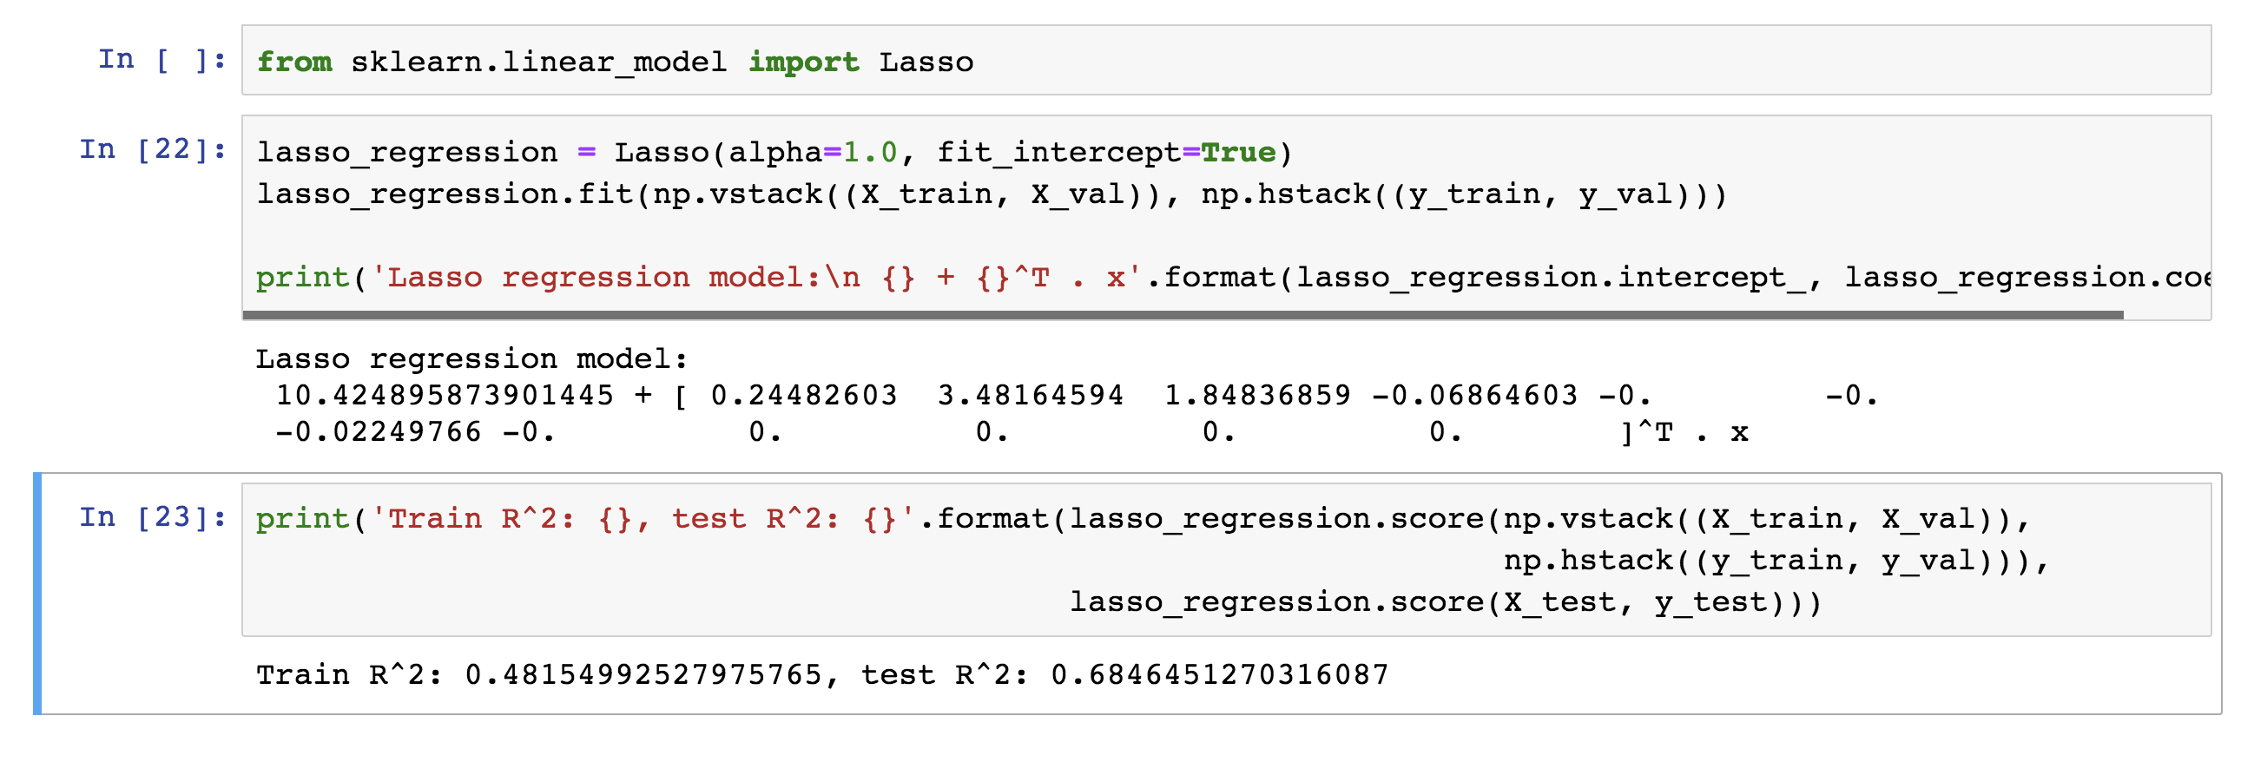
LASSO Regression
Hence, we often say that L_{LASSO} is the loss function for l₁ regularization.
Finding the model parameters β_{LASSO} that minimize the l₁ regularized loss function is called LASSO regression.

Slide 54
Ridge Regression
Alternatively, we can choose a regularization term that penalizes the squares of the parameter magnitudes. Then, our regularized loss function is:
Note that is the l₂ norm of the vector β

Slide 55
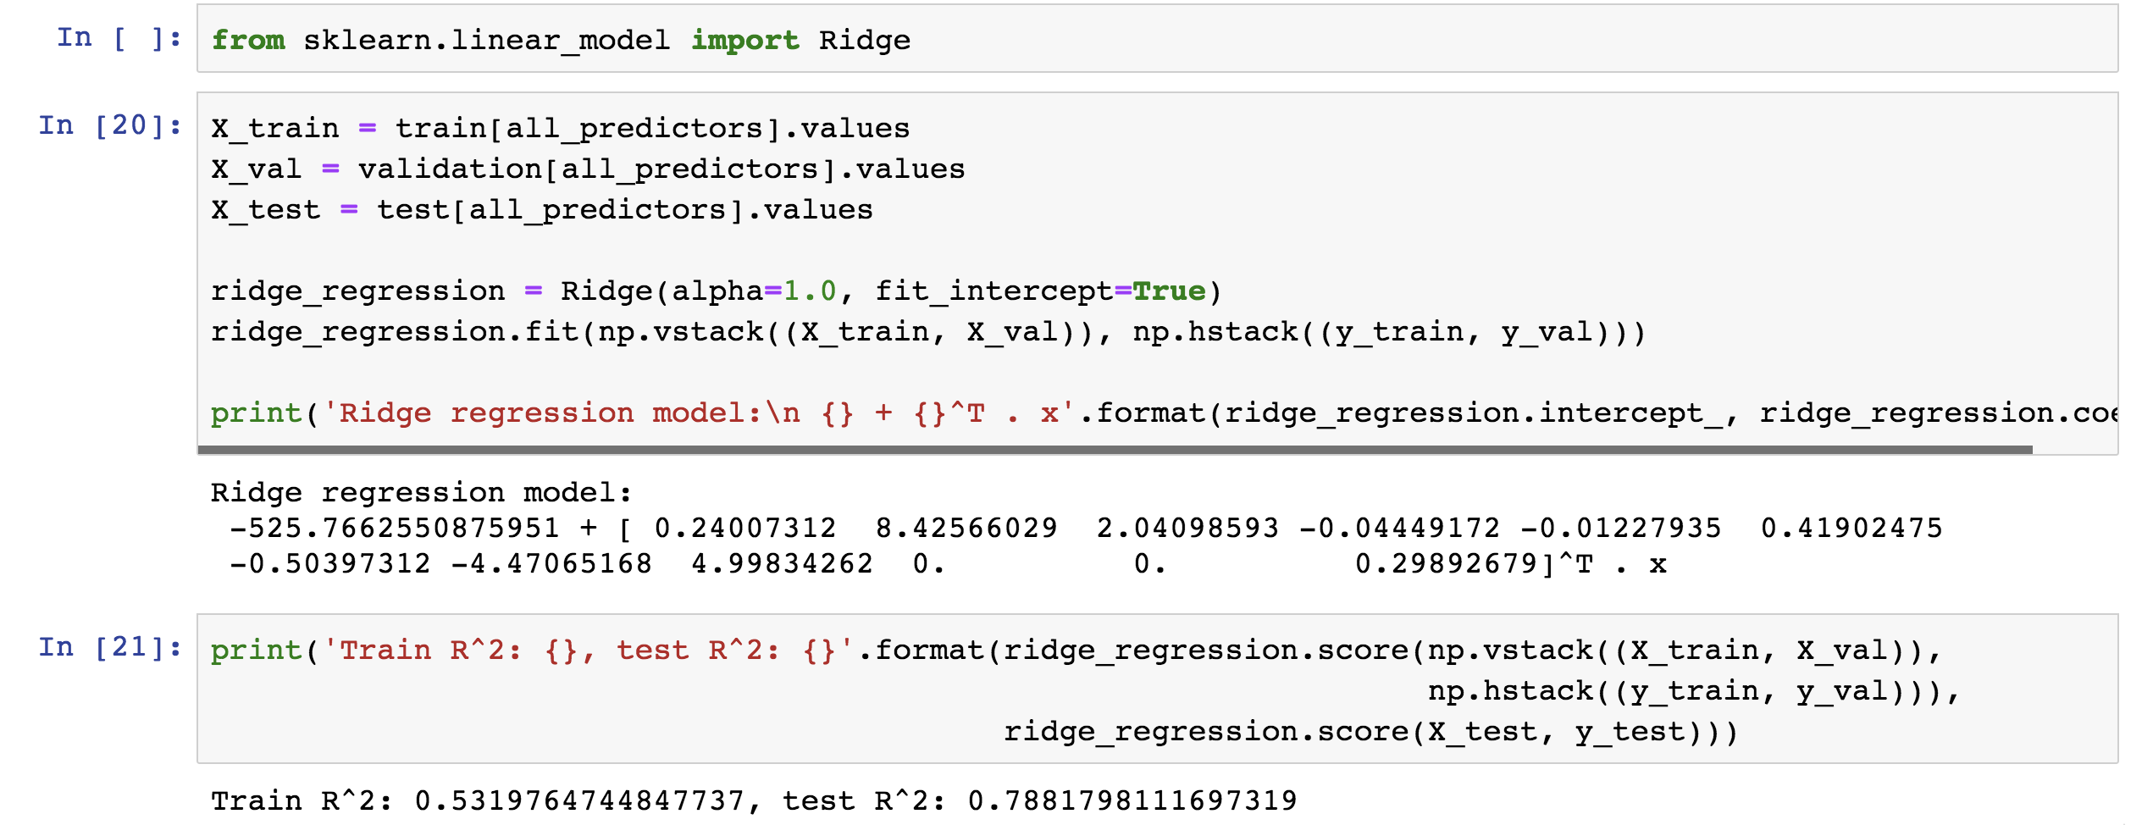
Ridge Regression
Hence, we often say that L_{ridge} is the loss function for l₂ regularization.
Finding the model parameters β_{ridge} that minimize the l₂ regularized loss function is called ridge regression.

Slide 56
Choosing λ
In both ridge and LASSO regression, we see that the larger our choice of the regularization parameter λ, the more heavily we penalize large values in β,
If λ is close to zero, we recover the MSE, i.e. ridge and LASSO regression is just ordinary regression.
If λ is sufficiently large, the MSE term in the regularized loss function will be insignificant and the regularization term will force β_{ridge} and β_{LASSO} to be close to zero.
To avoid ad-hoc choices, we should select λ using cross-validation.

Slide 57
Ridge - Computational complexity
Solution to ridge regression:
The solution of the Ridge/Lasso regression involves three steps
Select λ
Find the minimum of the ridge/Lasso regression cost function (using linear algebra) as with the multiple regression and record the R² on the test set.
Find the λ that gives the largest R²

Slide 58
The Geometry of Regularization

Slide 59
Variable Selection as Regularization
Since LASSO regression tend to produce zero estimates for a number of model parameters - we say that LASSO solutions are sparse - we consider LASSO to be a method for variable selection.
Many prefer using LASSO for variable selection (as well as for suppressing extreme parameter values) rather than stepwise selection, as LASSO avoids the statistic problems that arises in stepwise selection.
Question: What are the pros and cons of the two approaches?

